Slide 1

AML
CS611
MLE
Assignment 1
Prepared By:
LUO ZHICHENG
01452109
www.smu.edu.com

Slide 2












Business Problem
Loan Default Classifications
Data Preparation for modeling
Data Scientist
Compliance Officer
Goal: Deliver clean, well-structured feature and label stores for model training.
A reliable Medallion Architecture pipeline ensures consistent, high-quality input data for building accurate and robust predictive models.
Goal: Ensure data integrity, traceability, and compliance in data preparation.
Clear lineage and structured data storage support auditability and regulatory reporting requirements.
The financial institution faces credit risk due to borrowers potentially defaulting on loans.
The business problem is to reduce financial losses by predicting loan defaults at the point of application, enabling better lending decisions and risk management.
Business Manager
Goal: Minimize financial losses by enabling early detection of high-risk loan applicants.
Predictive insights will help reduce default rates and improve the overall profitability of the loan portfolio.
Our Solutions:
ML Flowchart
Data Engineer
Product Manager
Goal: Implement scalable, maintainable data pipelines using the Medallion Architecture.
Bronze, Silver, and Gold layers will provide a modular, reproducible foundation for future enhancements and monitoring.
Goal: Support smarter, data-driven loan approval decisions at the point of application.
Integrating model predictions into the customer journey enables faster approvals for low-risk applicants and safeguards against bad debt.
Feature Retrieval
Trained ML Model
Loan Application
Approved
Flag for Review / Reject

Slide 3
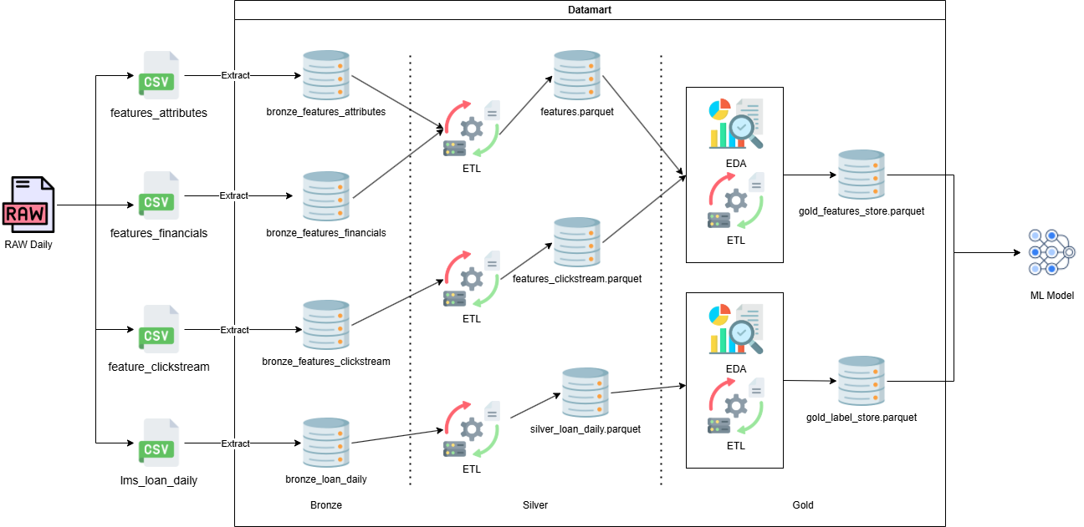
Medallion Architecture

Slide 4
Data preprocessing ETL part 1 – Data Cleaning
Column Name | Data Type | Source | Transformation | Remarks
Customer_ID | StringType() | attr_types
Name | StringType() |  | Removes all characters except letters, spaces, dots, apostrophes, and hyphens.
Age | IntegerType() |  | Keeps only digits, casts to Integer, sets to None if not in the valid range [0, 120].
SSN | StringType() |  | Removes all non-digit and non-dash characters, keeps value only if it matches XXX-XX-XXXX.
Occupation | StringType() |  | Sets to None if blank or contains only underscores; otherwise keeps the original value.
snapshot_date | DateType()
Customer_ID | StringType() | fin_types
Annual_Income | FloatType() |  | Removes underscores and casts to Float.
Monthly_Inhand_Salary | FloatType()
Num_Bank_Accounts | IntegerType() |  | Keeps only if integer < 100; otherwise set to None.
Num_Credit_Card | IntegerType() |  | Keeps only if integer < 50; otherwise set to None.
Interest_Rate | IntegerType() |  | Keeps only if integer in range [0, 99]; otherwise set to None.
Num_of_Loan | IntegerType() |  | Removes underscores, keeps only if in range [0, 19]; otherwise set to None.
Type_of_Loan | StringType()
Delay_from_due_date | IntegerType()
Num_of_Delayed_Payment | IntegerType() |  | Removes underscores, keeps only if in range [0, 29]; otherwise set to None.
Changed_Credit_Limit | FloatType() |  | Removes underscores; sets to None if blank, else casts to Float.
Num_Credit_Inquiries | IntegerType()
Credit_Mix | StringType() |  | Sets to None if blank or all underscores; otherwise keeps original.
Outstanding_Debt | FloatType() |  | Removes underscores and casts to Float.
Credit_Utilization_Ratio | FloatType()
Credit_History_Age | StringType()
Payment_of_Min_Amount | StringType()
Total_EMI_per_month | FloatType()
Amount_invested_monthly | FloatType() |  | Keeps only digits and decimal point, casts to Float.
Payment_Behaviour | StringType() |  | Sets to None if value is exactly "!@9#%8"; otherwise keeps original.
Monthly_Balance | FloatType()
snapshot_date | DateType()

Slide 5
Data preprocessing ETL part 2 – Outlier Removal
Column Name | Data Type | Source | Transformation | Remarks
Customer_ID | StringType() | attr_types
Name | StringType()
Age | IntegerType()
SSN | StringType()
Occupation | StringType()
snapshot_date | DateType()
Customer_ID | StringType() | fin_types
Annual_Income | FloatType() |  | Outliers' columns are nullify based on the IQR rule to retain only typical income values within the range [Q1 - 1.5×IQR, Q3 + 1.5×IQR].
Monthly_Inhand_Salary | FloatType()
Num_Bank_Accounts | IntegerType()
Num_Credit_Card | IntegerType()
Interest_Rate | IntegerType()
Num_of_Loan | IntegerType()
Type_of_Loan | StringType()
Delay_from_due_date | IntegerType()
Num_of_Delayed_Payment | IntegerType()
Changed_Credit_Limit | FloatType()
Num_Credit_Inquiries | IntegerType() |  | Outliers are filtered using the same IQR rule to remove unusually high or low numbers of credit inquiries.
Credit_Mix | StringType()
Outstanding_Debt | FloatType()
Credit_Utilization_Ratio | FloatType()
Credit_History_Age | StringType()
Payment_of_Min_Amount | StringType()
Total_EMI_per_month | FloatType()
Amount_invested_monthly | FloatType()
Payment_Behaviour | StringType()
Monthly_Balance | FloatType()
snapshot_date | DateType()

Slide 6
Data preprocessing ETL part 3 – Feature Engineering
Column Name | Data Type | Transformation Details | Descriptions
new_loan_to_income_ratio | FloatType() | Outstanding_Debt / Annual_Income | Measures how much debt a person has compared to their annual income. High values may indicate financial risk.
new_loan_type_count | IntegerType() | Count of distinct loan types split by comma | Counts how many different types of loans a person has (e.g., personal, car, home loans).
new_salary_debt_ratio | FloatType() | Outstanding_Debt / (Monthly_Inhand_Salary + 1e-6) | Shows how much debt a person has compared to their monthly take-home salary. Helps assess repayment ability.
new_inquiry_to_loan_ratio | FloatType() | Num_Credit_Inquiries / (Num_of_Loan + 1e-6) | Indicates how often a person applied for credit (inquiries) relative to the number of loans they took. High values may suggest frequent but unsuccessful credit applications.
new_credit_history_months | IntegerType() | Extract years and months from Credit_History_Age and convert to total months | Converts "X Years and Y Months" into a single value in months, representing the total length of a person’s credit history.
new_Payment_Behaviour_code | IntegerType() | Encode payment behaviour into integers based on specific strings | Encodes payment behavior into numeric categories, reflecting how much and how frequently a person spends and pays.
new_Payment_of_Min_Amount_code | IntegerType() | Encode Payment_of_Min_Amount (NM=0, Yes=1, No=2) | Encodes whether a person pays the minimum amount due (Yes/No/NM) into numeric codes. Useful for modeling financial responsibility.
new_Credit_Mix_code | IntegerType() | Encode Credit_Mix (Good=3, Standard=2, Bad=1) | Encodes the mix of credit types (Good, Standard, Bad) into numerical values for machine learning.
new_Occupation_code | IntegerType() | Map Occupation to integer codes from 0 to 14 | Converts the occupation type into numeric codes to enable modeling with categorical data.

Slide 7
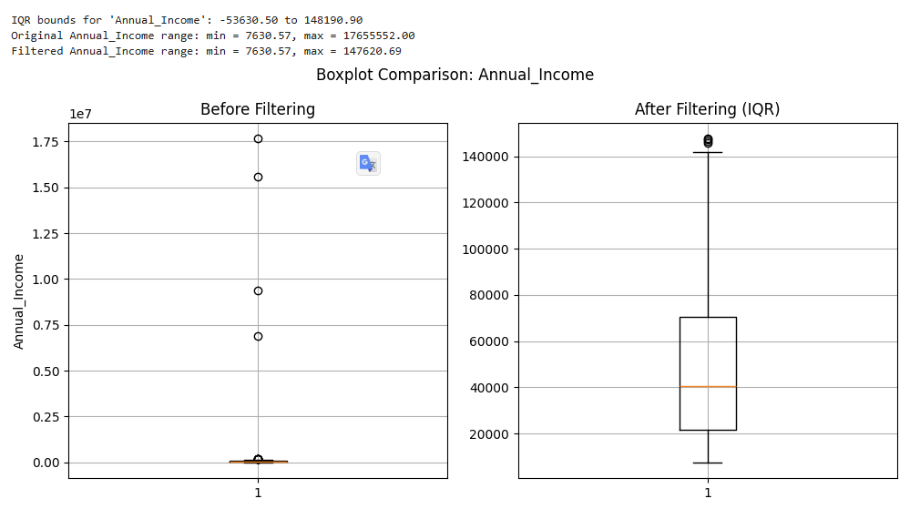
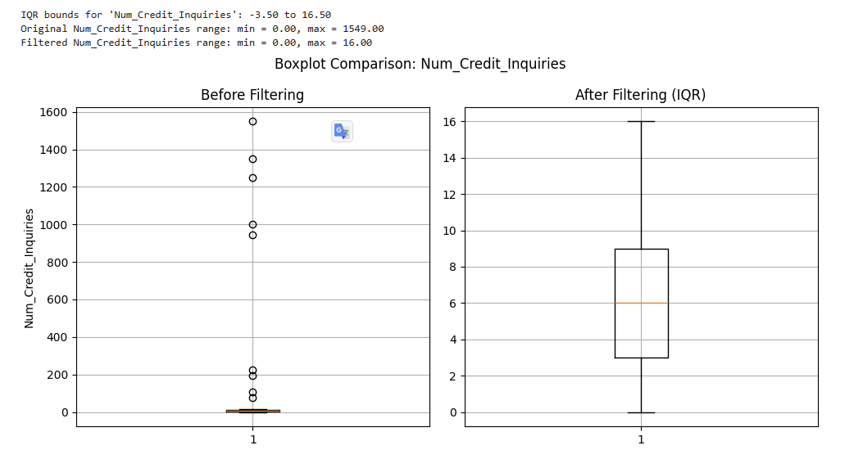
ETL And EDA Boxplot comparison
Initiative:
Clean variables using IQR-based outlier filtering to improve data quality for modeling and visualization.
Variables analyzed:
Annual_Income
Num_Credit_Inquiries
Overall Takeaways
Outlier removal is a critical EDA step for skewed financial features like income.
IQR filtering offers a statistically sound method for cleaning continuous variables without hardcoding thresholds.
For modeling, transformed income (e.g., log scale) may still be necessary due to remaining positive skew, but this filtering provides a solid base.

Slide 8
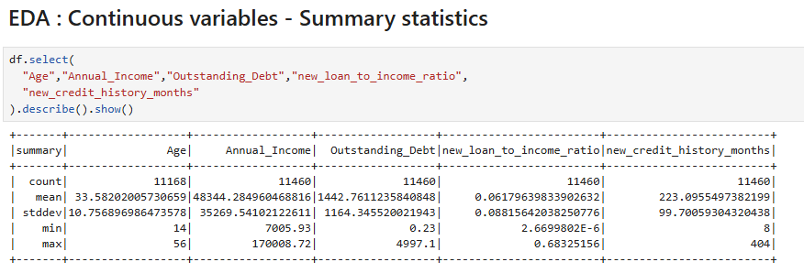
Exploratory Data Analysis Continues Variables
Initiative:
Perform exploratory data analysis (EDA) on key continuous variables to better understand customer financial profiles and loan behavior for downstream modeling (e.g., predicting loan default risk).
Variables analyzed:
Age
Annual_Income
Outstanding_Debt
new_loan_to_income_ratio
new_credit_history_months

Slide 9
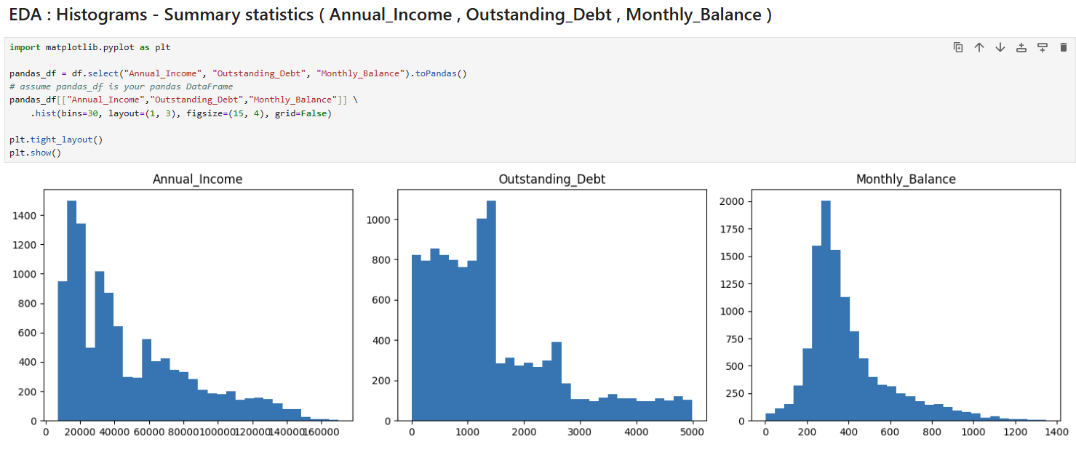
Exploratory Data Analysis Histograms
Initiative:
To understand the distribution and skewness of key financial variables using histograms. This step informs potential feature transformations (e.g., log-scaling) and modeling strategies.
Variables analyzed:
Annual_Income
Outstanding_Debt
Monthly_Balance

Slide 10
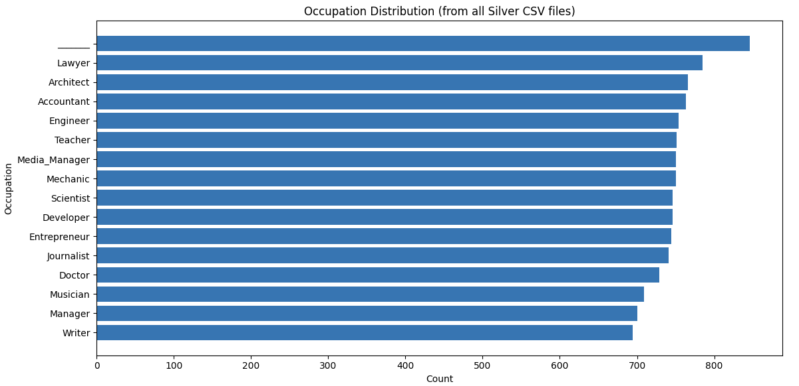
Exploratory Data Analysis Occupation Distribution
Initiative:
Understand the distribution of occupations across your dataset to:
Identify dominant user segments
Guide feature encoding strategies
Support demographic-based risk profiling
Variables analyzed:
Occupation
Overall Takeaways
Lawyers dominate the dataset. Ensure model generalizability isn't biased by this overrepresentation.
Occupational diversity is good, covering a broad professional spectrum.
This analysis supports future segmentation or cohort analysis, such as:
Income vs. occupation
Default risk by profession
Customized product offerings

Slide 11
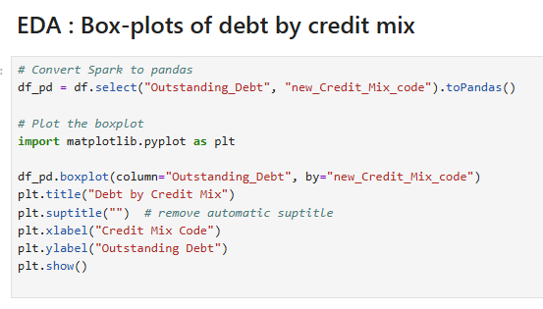
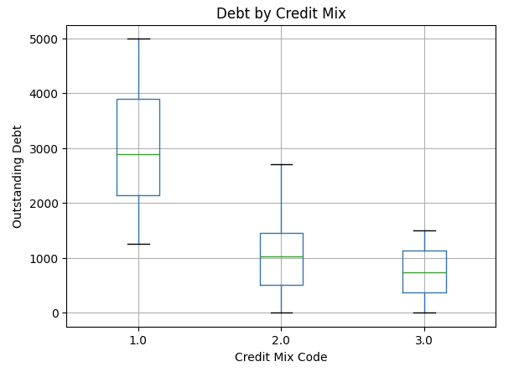
Exploratory Data Analysis Box-plots
Initiative:
Analyze how outstanding debt varies across different types of credit mixes using boxplots. This step aims to discover relationships between credit behavior and debt level for downstream feature engineering or customer segmentation.
Variables analyzed:
Outstanding_Debt
new_Credit_Mix_code
Overall Takeaways:
Customers with worse credit mix tend to carry higher and more varied debt, making them higher risk.
This relationship can be very useful in risk scoring models, helping prioritize loan approvals, limits, or interest rates.

Slide 12
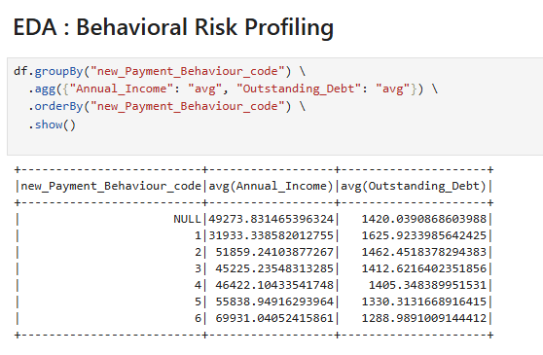
Exploratory Data Analysis Behavioral Risk Profiling
Initiative
Group users by payment behavior codes to understand financial risk profiles based on average Annual Income and Outstanding Debt.
Variables analyzed:
new_Payment_Behaviour_code
Annual_Income
Outstanding_Debt
Overall Takeaways
Code 1 group is financially vulnerable — they may need tighter credit control.
Code 6 represents prime customers — low risk and possibly eligible for promotions or preferred rates.
Payment behavior is highly predictive of financial health and can be used directly as a risk tiering feature.

Slide 13
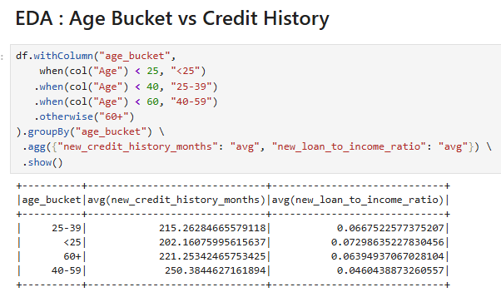
Exploratory Data Analysis Age Bucket vs Credit History
Initiative
Analyze how age group influences both:
Credit history length (new_credit_history_months)
Debt burden (new_loan_to_income_ratio)
Variables analyzed:
new_credit_history_months
new_loan_to_income_ratio
Overall Takeaways
Debt-to-income ratio decreases with age, showing that younger users are more leveraged.
Credit history grows with age, as expected, but the 40–59 group stands out as having the most established credit and least financial strain.
These trends suggest that age bucket is a valuable feature in credit scoring models, especially when combined with behavioral and income data.

Slide 14
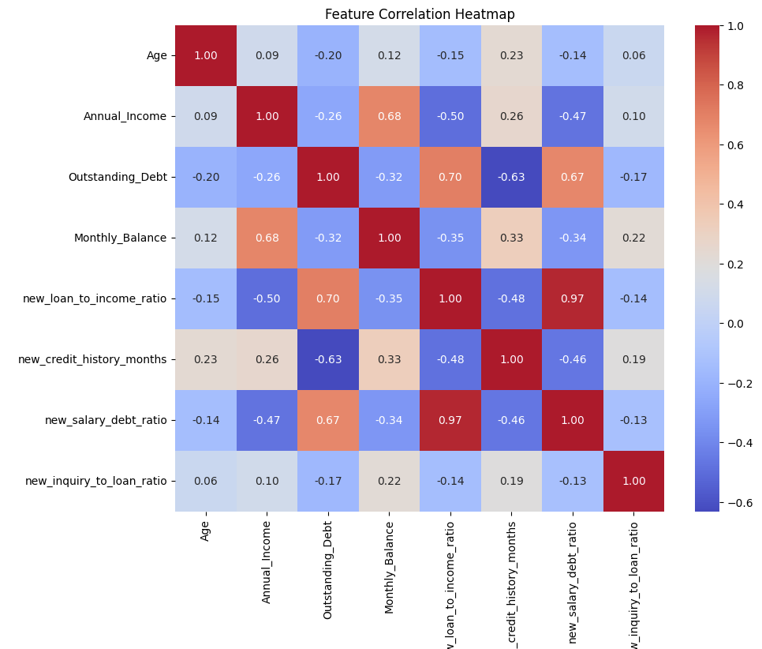
Exploratory Data Analysis Feature Correlation Heatmap
Initiative
Understand the relationships between numeric features to:
Detect multicollinearity
Identify strong predictors
Support feature selection or transformation
Overall Takeaways
new_loan_to_income_ratio and new_salary_debt_ratio – almost perfectly correlated (0.97), choose one to avoid redundancy.

